Slide 1

Imaging and Analysis of Post-processing for Discrete Element Method and its Application
Algorithm Description & Calculation Example
Numerical Simulation Experiment
Nanjing University
WEI Huajing
04/07/2020

Slide 2
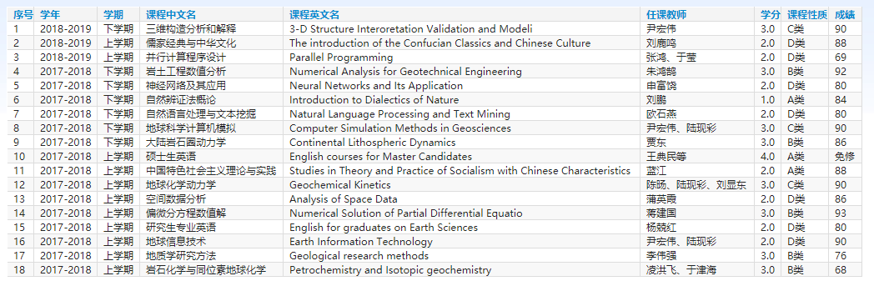
Curriculum
18 courses for 45 credits

Slide 3
Workload
Python Code for Post-processing Algorithm: 56172 lines
2D Compression Structural Experiment: 53 sets
Structural Deformation and Feature Map Figure: 5724 pieces

Slide 4
Outline
Introduction
Algorithm
Example
Experiment
Conclusion

Slide 5
Outline
Introduction
Algorithm
Example
Experiment
Conclusion

Slide 6
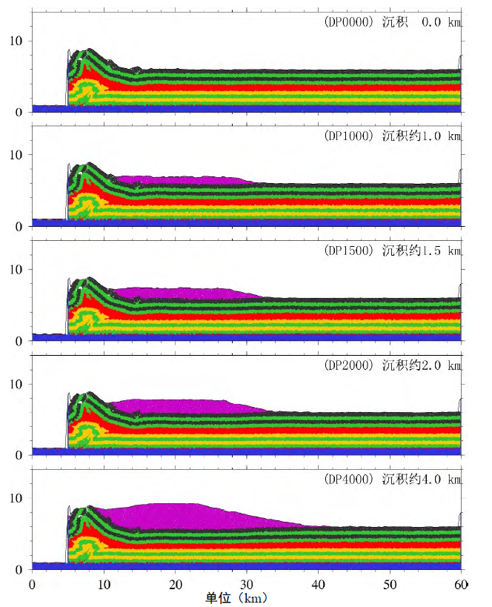
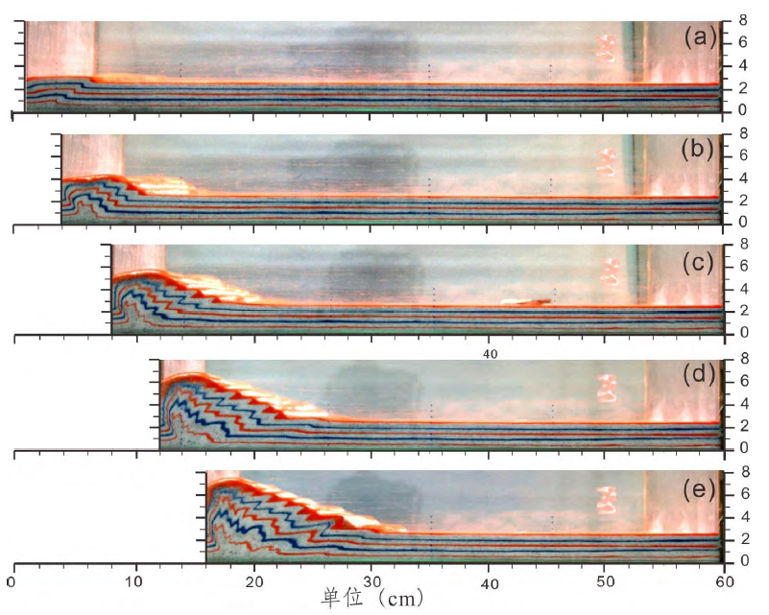
Structural Simulation

Slide 7
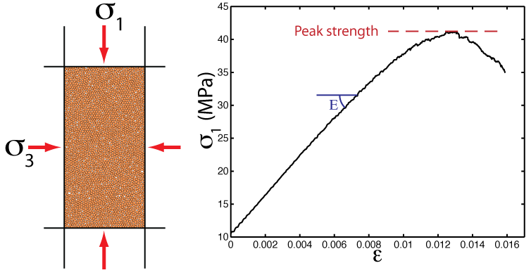
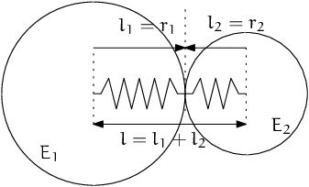
Numerical Simulation
DEM: Discrete Element Model
Micro-granular system for macroscopic object
Based on Newtonian mechanics
Masses of computation

Slide 8
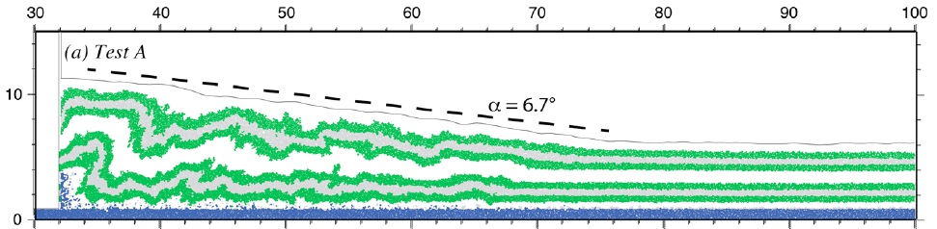
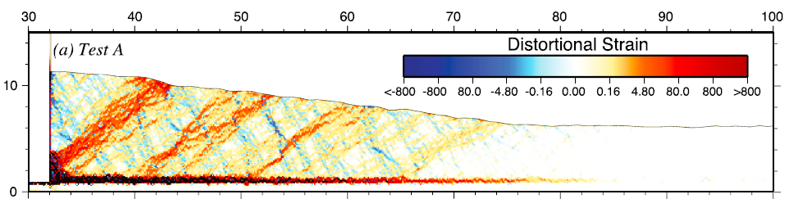
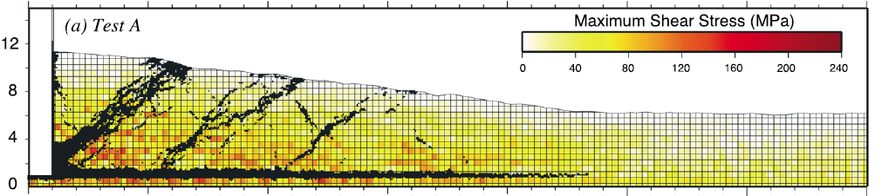
DEM Software

Slide 9
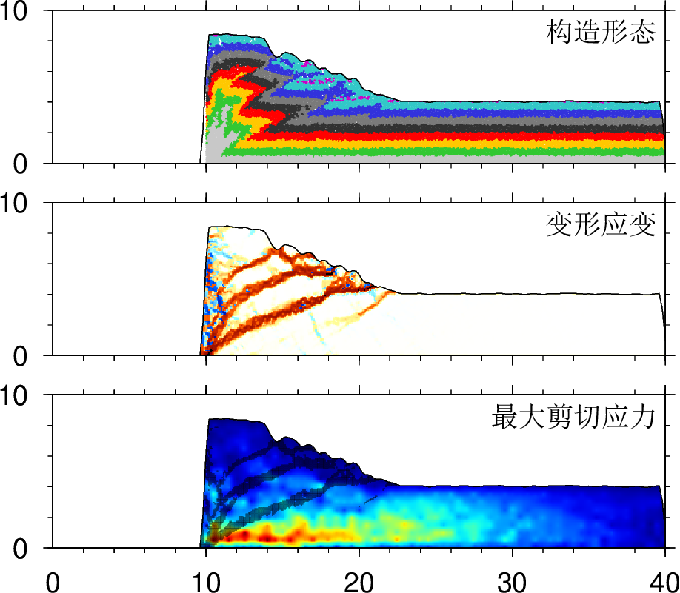
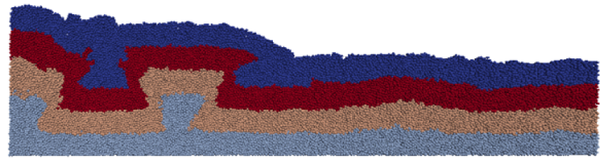
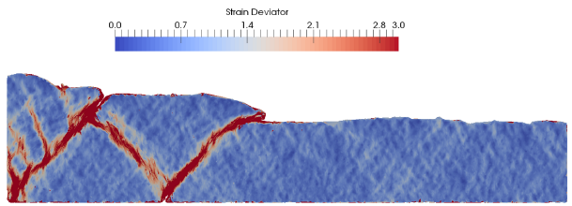
DEM Software

Slide 10
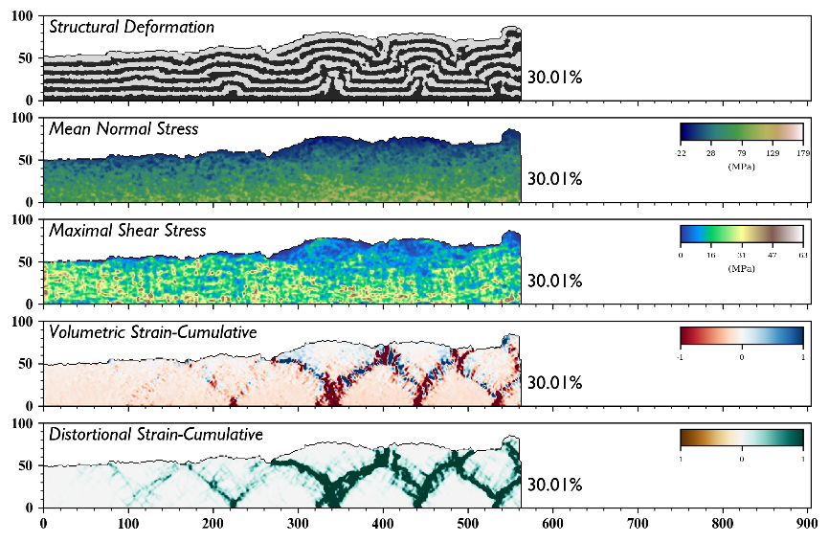
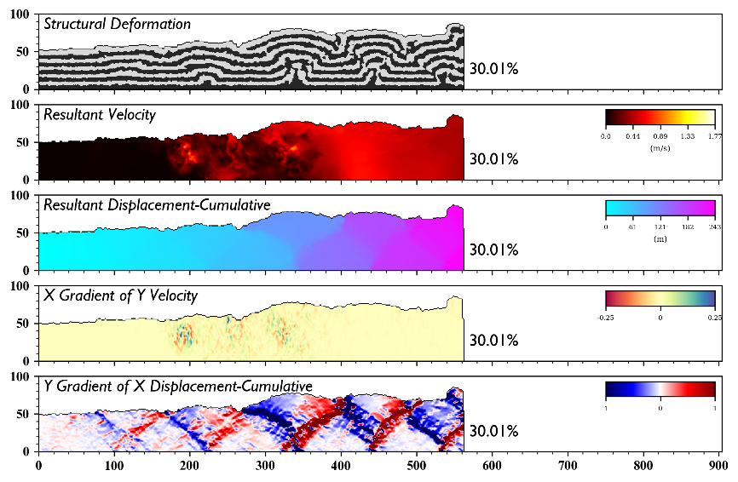
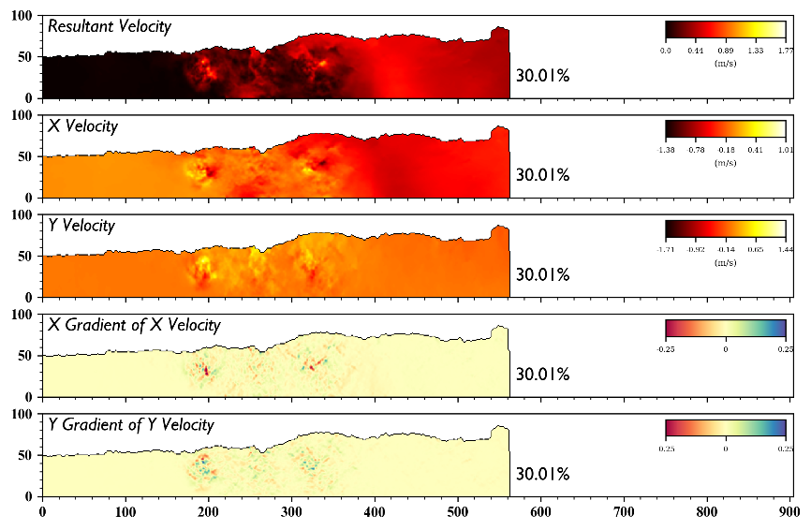
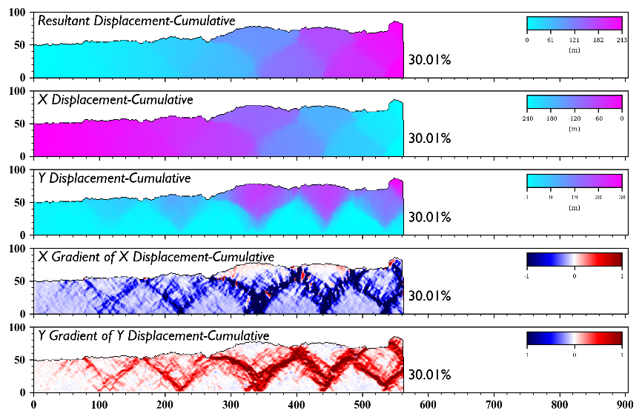
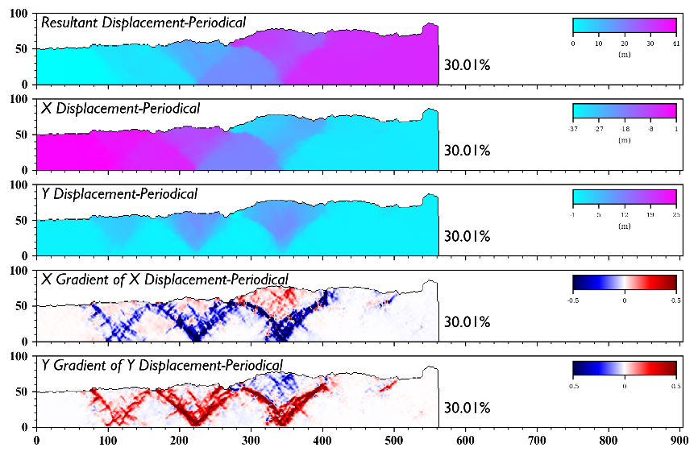
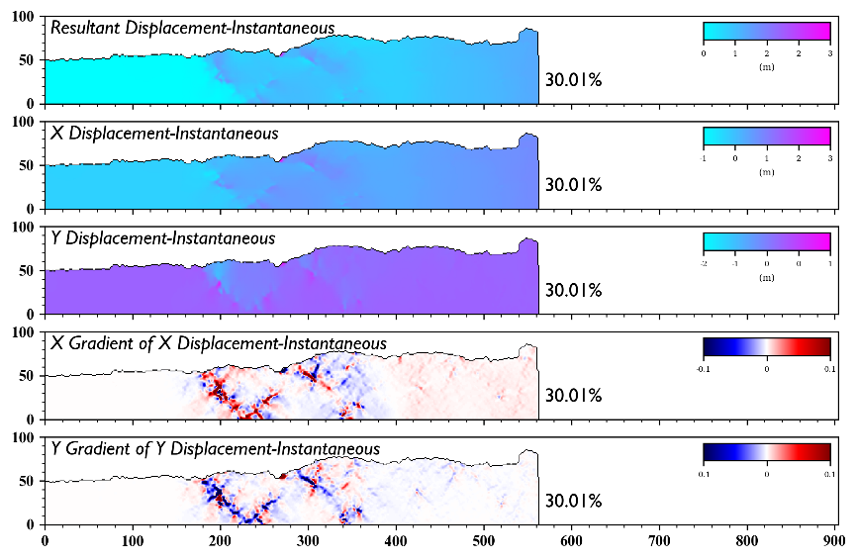
Multi-dimensional Analysis

Slide 11
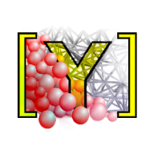
Software
YADE: Yet Another Dynamic Engine
Performed on Linux
Open Source
Python Command Line

Slide 12
Outline
Introduction
Algorithm
Example
Experiment
Conclusion

Slide 13

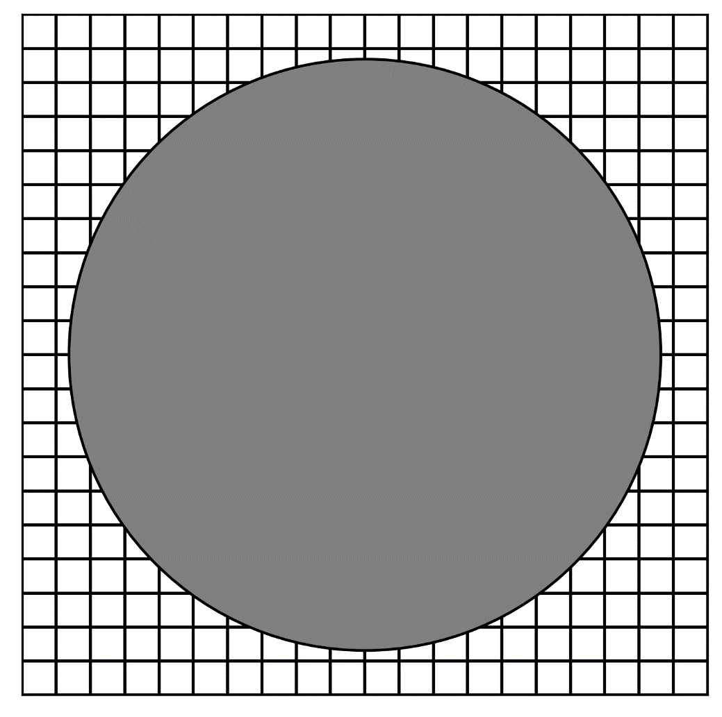
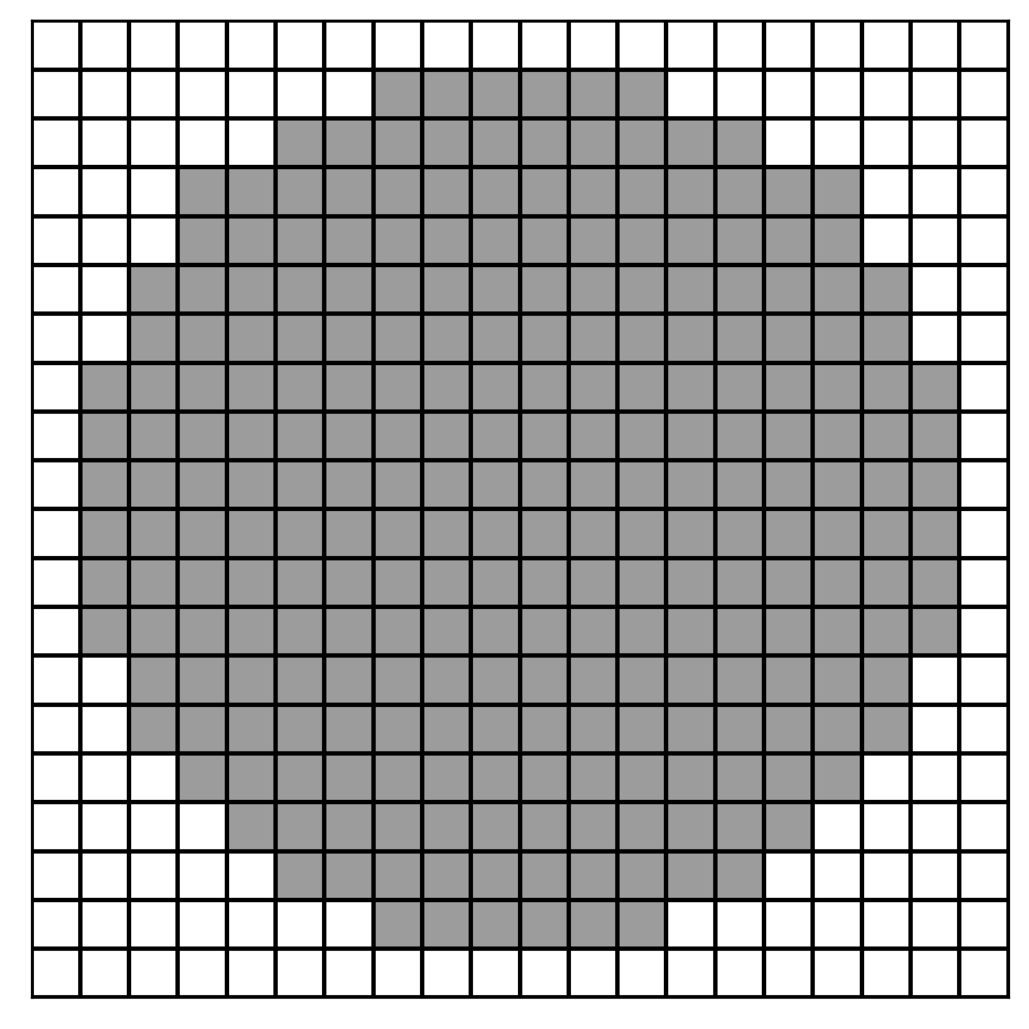


Rasterization
GitHub: https://github.com/jerryweihuajing/Post-Processing

Slide 14
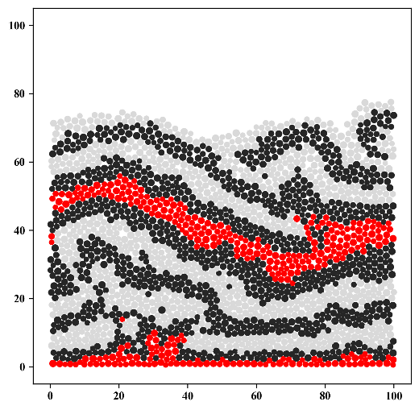
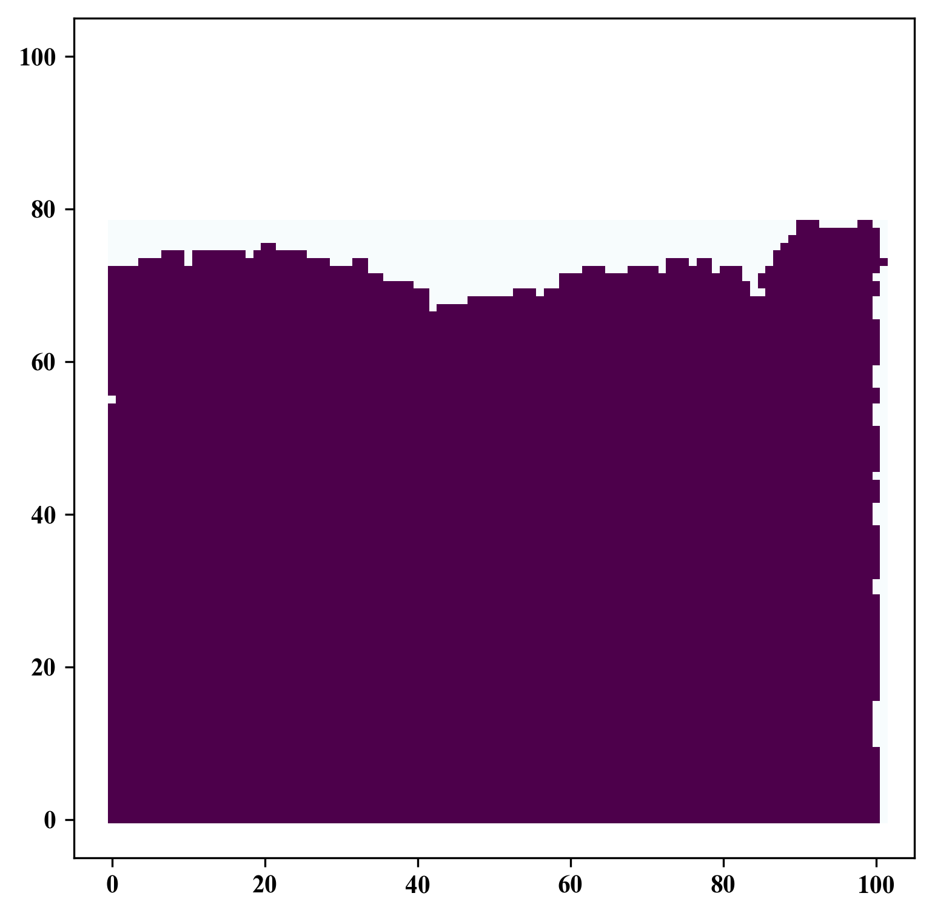
Rasterization
GitHub: https://github.com/jerryweihuajing/Post-Processing

Slide 15
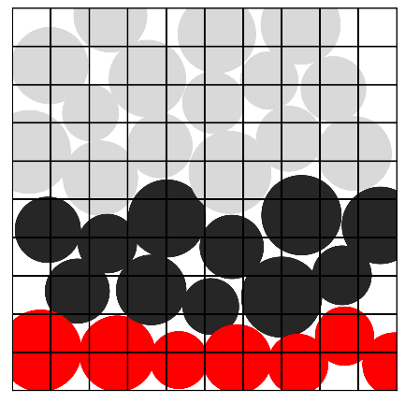
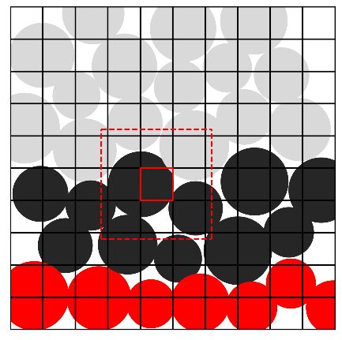
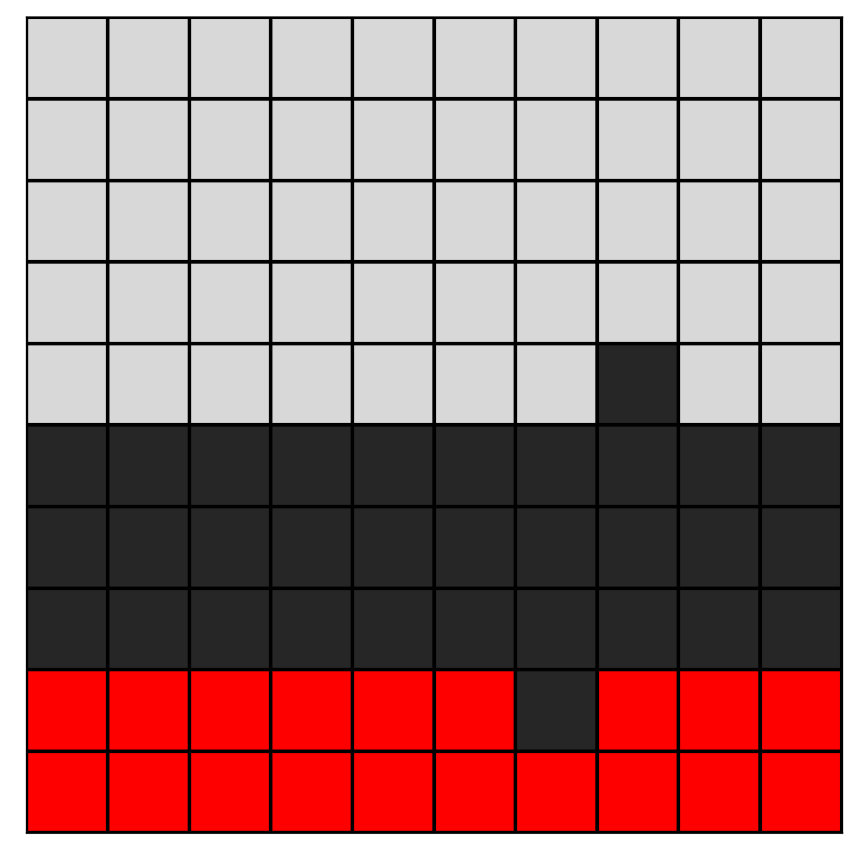
Rasterization
GitHub: https://github.com/jerryweihuajing/Post-Processing

Slide 16

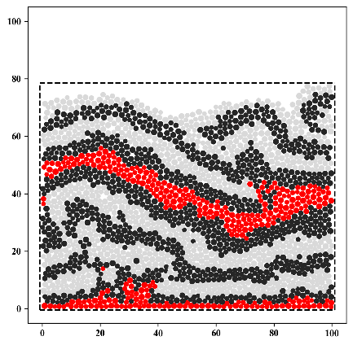
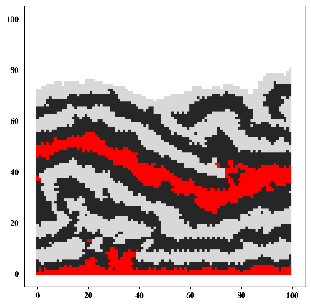
Rasterization
GitHub: https://github.com/jerryweihuajing/Post-Processing

Slide 17
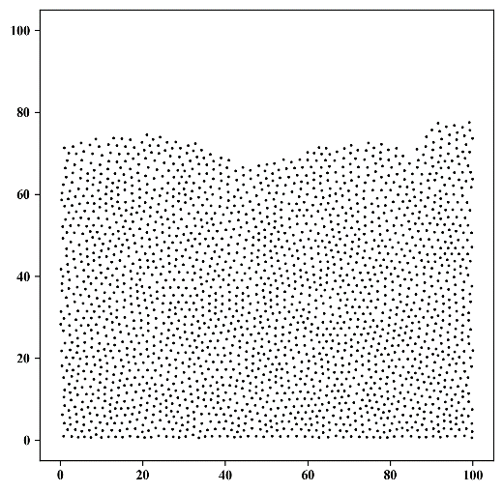
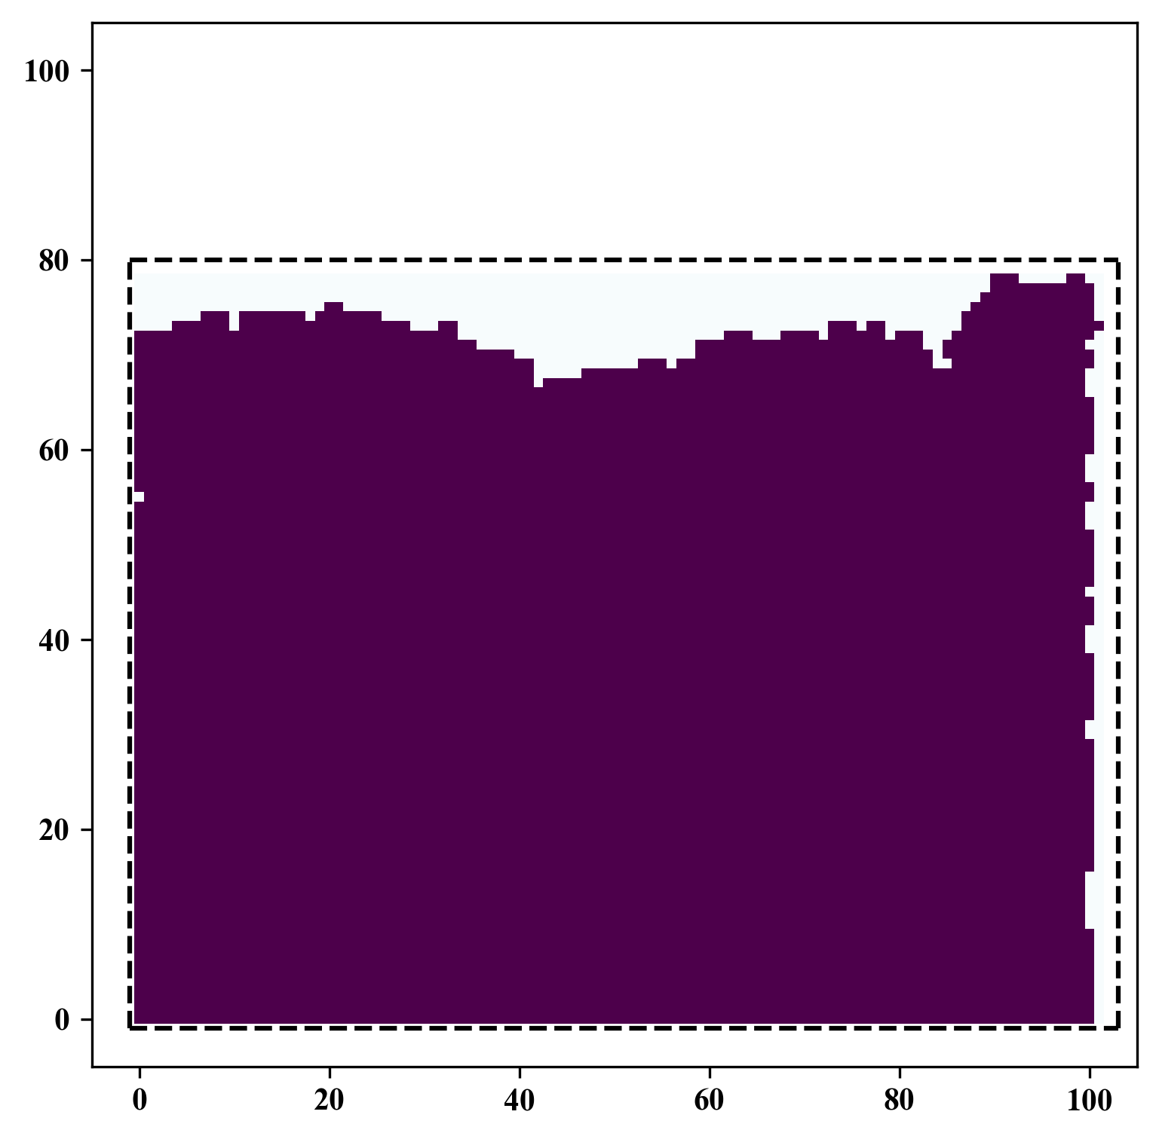
Spatial Interpolation
GitHub: https://github.com/jerryweihuajing/Post-Processing

Slide 18
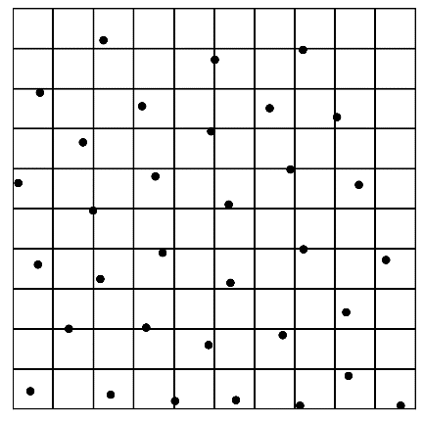
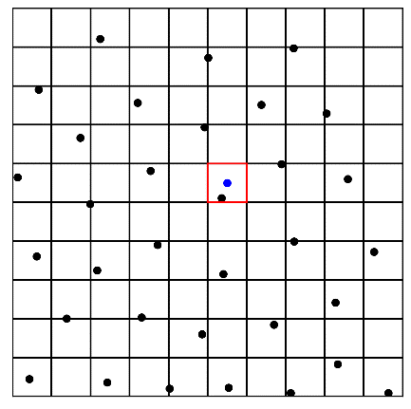
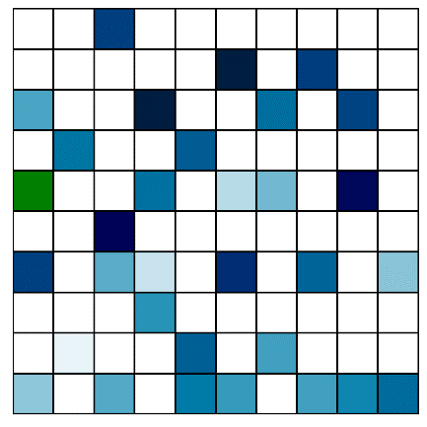
Spatial Interpolation
GitHub: https://github.com/jerryweihuajing/Post-Processing

Slide 19
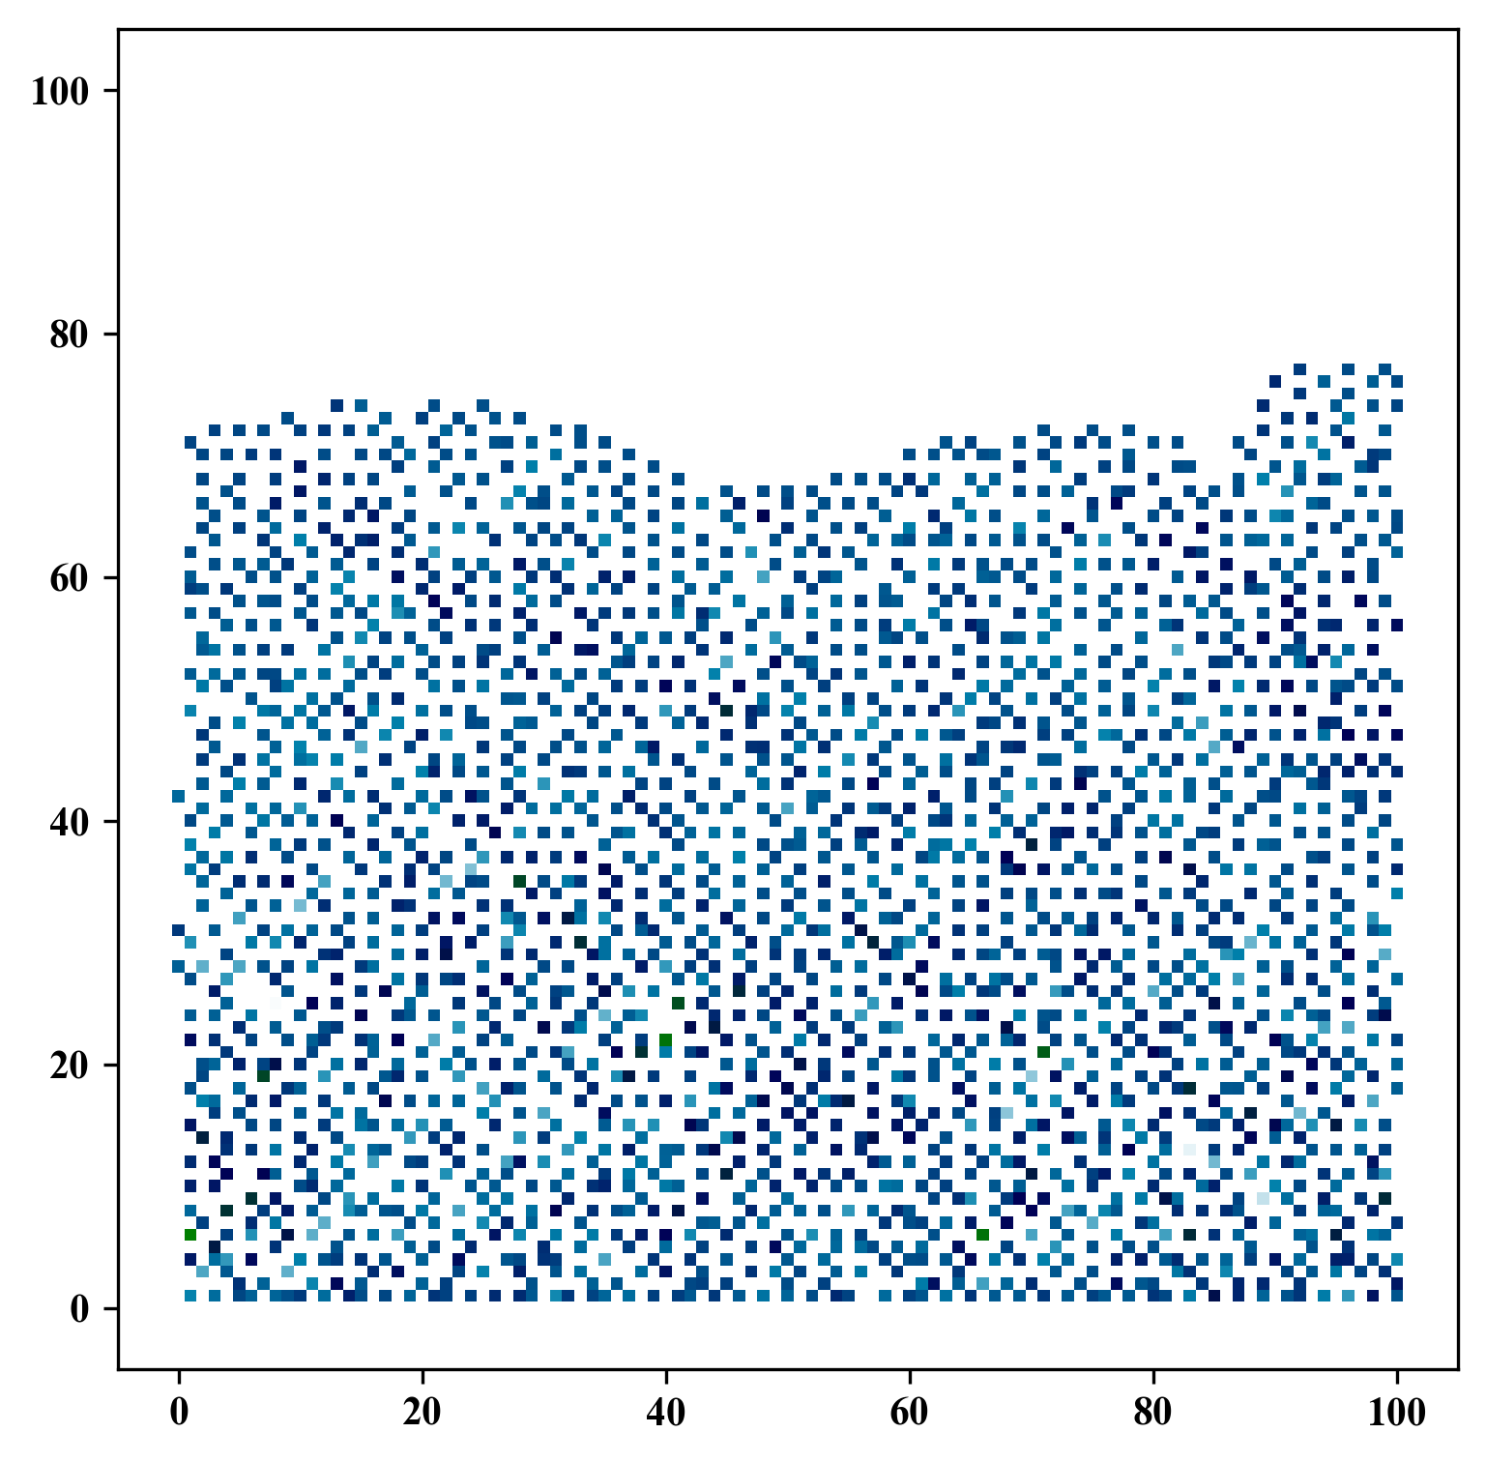
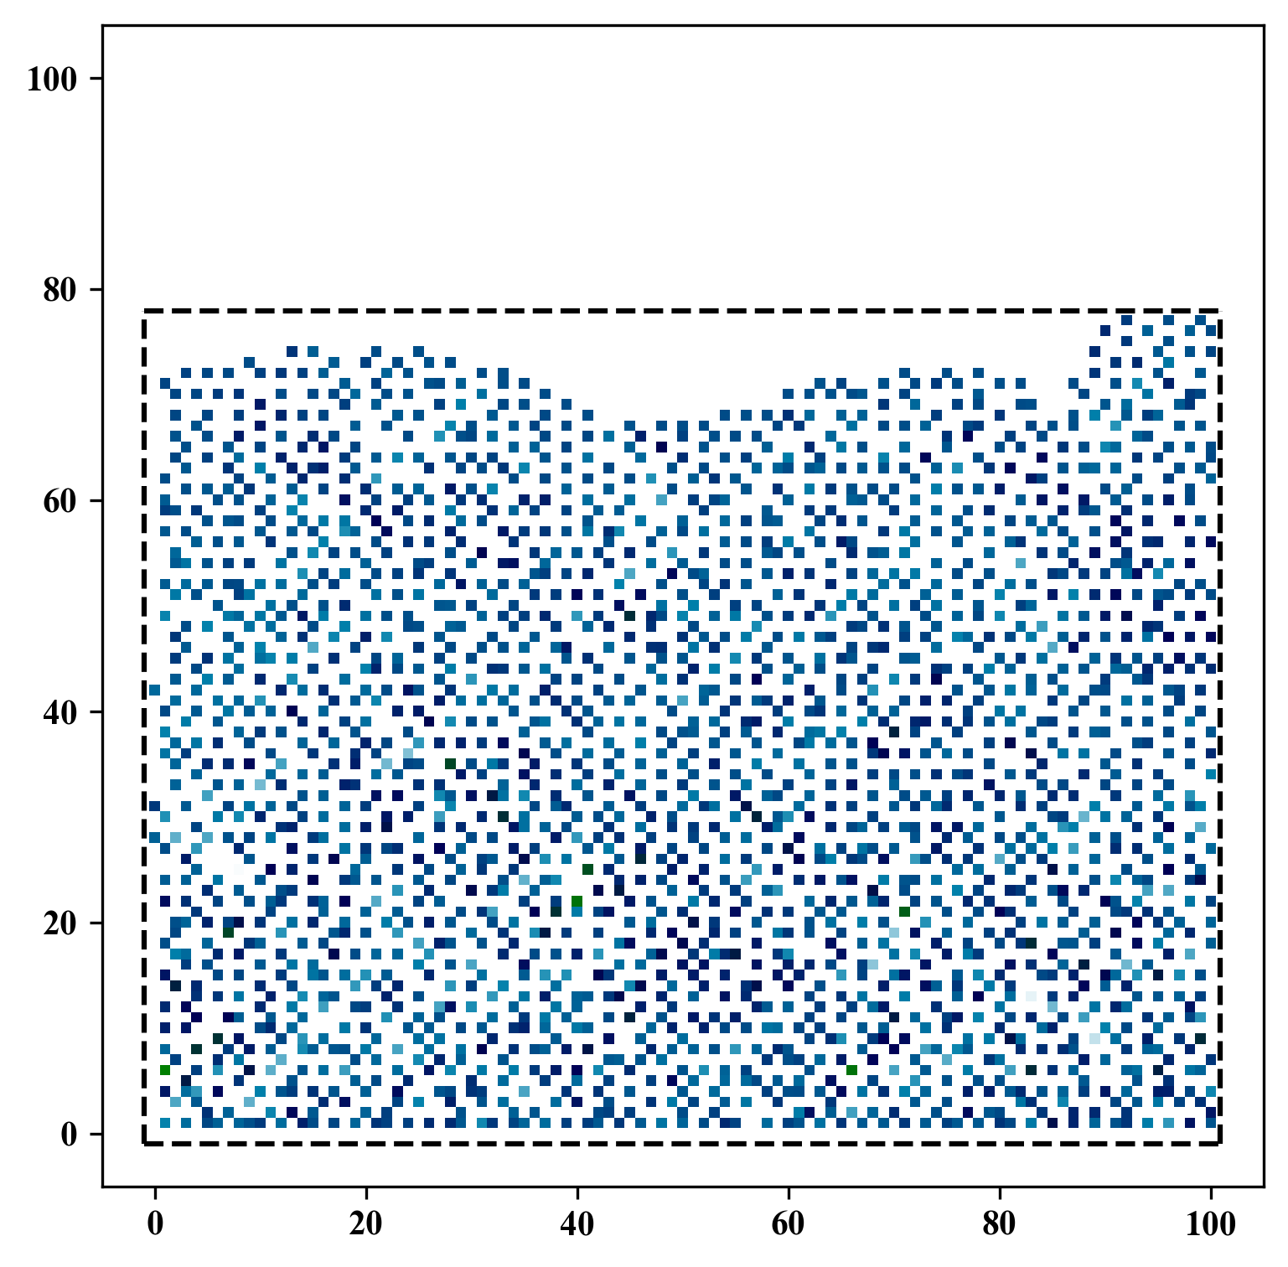
Spatial Interpolation
GitHub: https://github.com/jerryweihuajing/Post-Processing

Slide 20
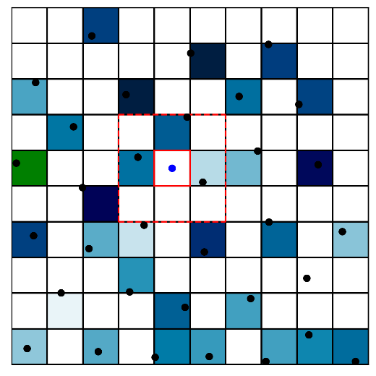
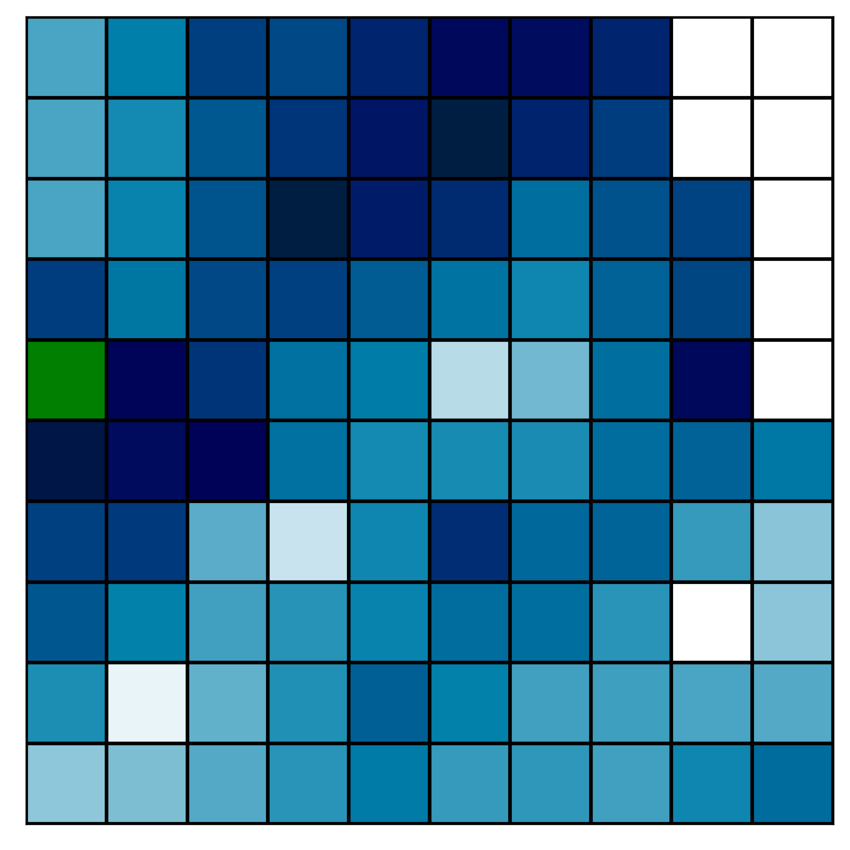
Spatial Interpolation
GitHub: https://github.com/jerryweihuajing/Post-Processing

Slide 21
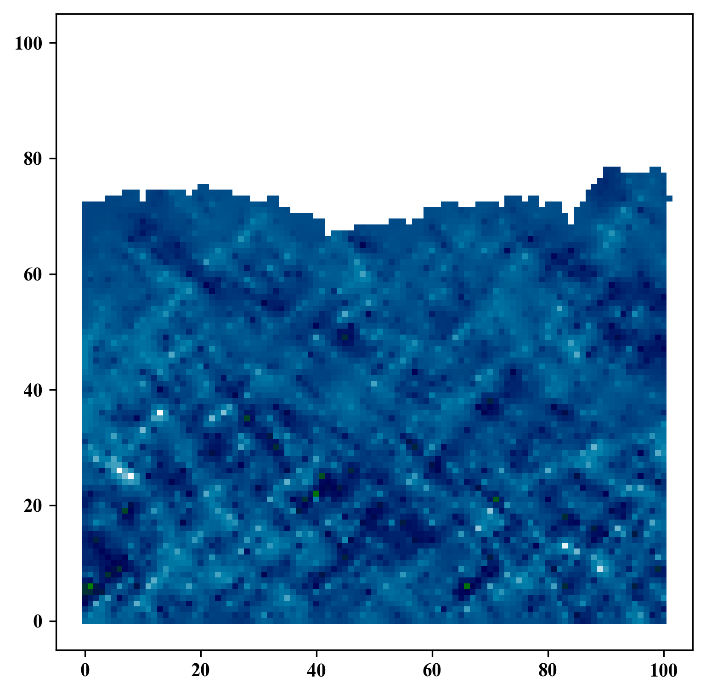
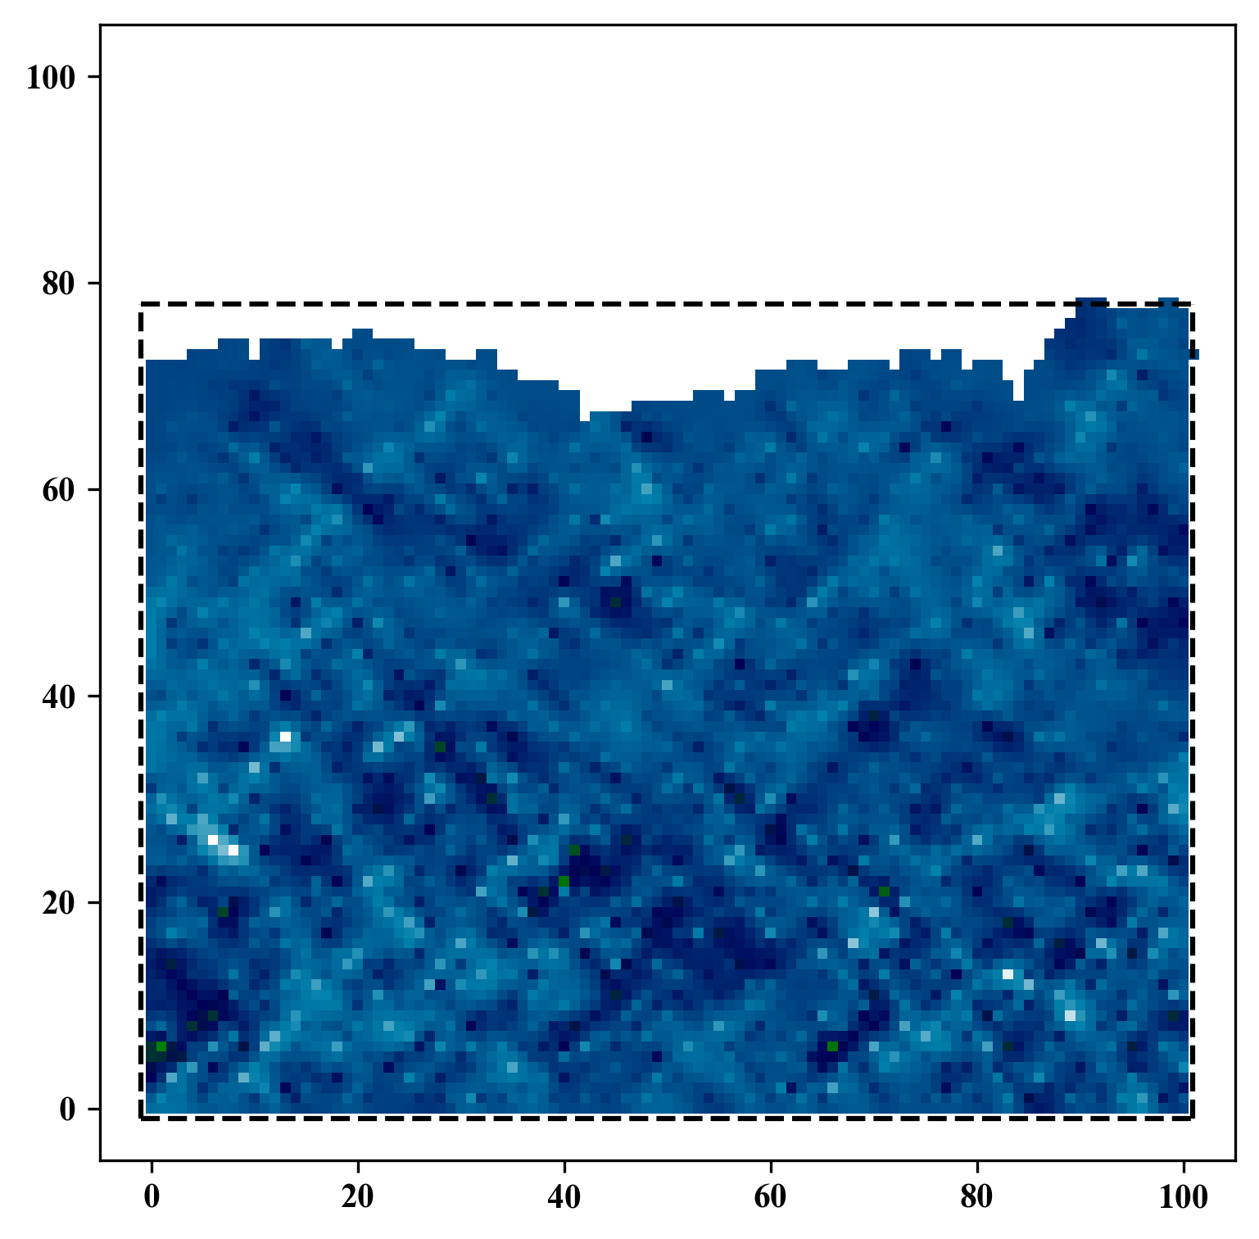
Spatial Interpolation
GitHub: https://github.com/jerryweihuajing/Post-Processing

Slide 22
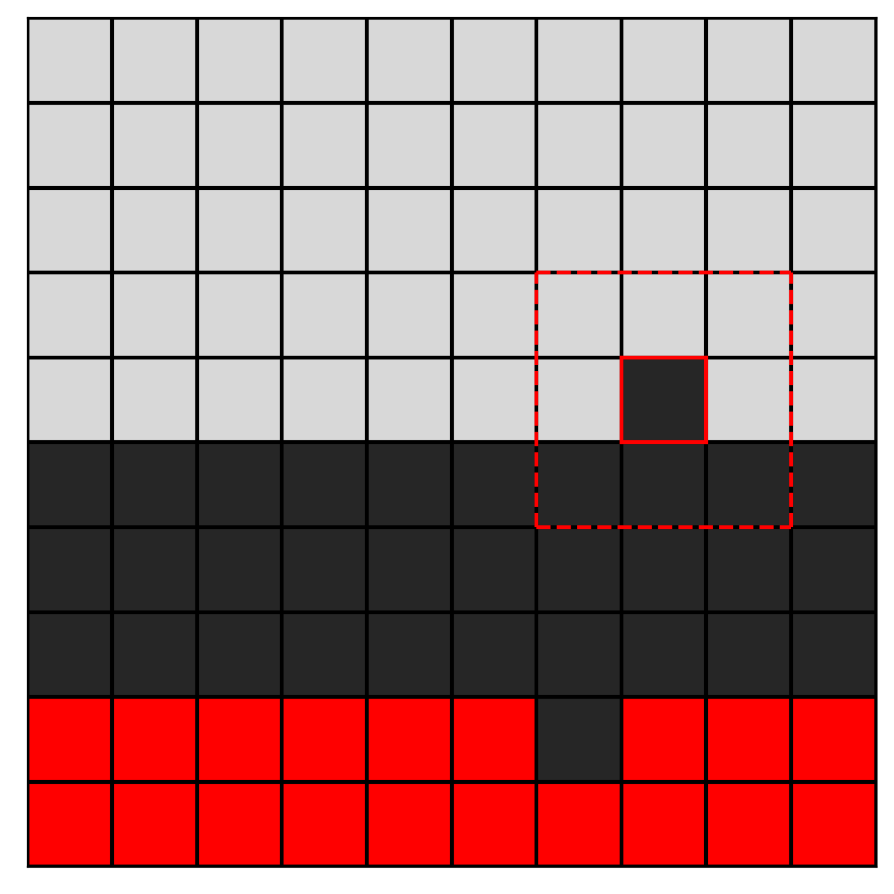
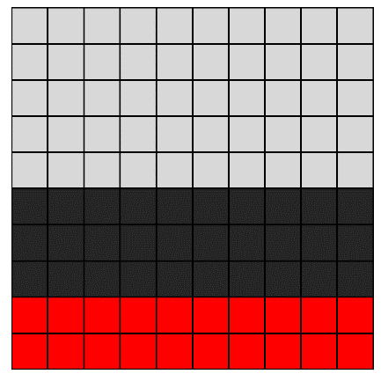
Gaussian Filtering
GitHub: https://github.com/jerryweihuajing/Post-Processing

Slide 23

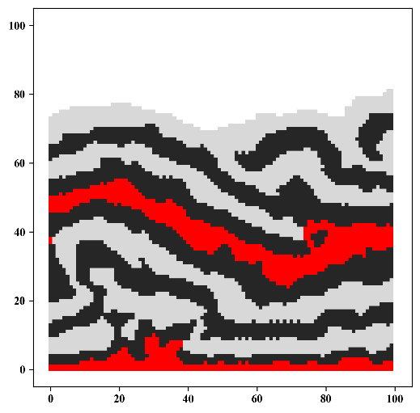
Gaussian Filtering
GitHub: https://github.com/jerryweihuajing/Post-Processing

Slide 24
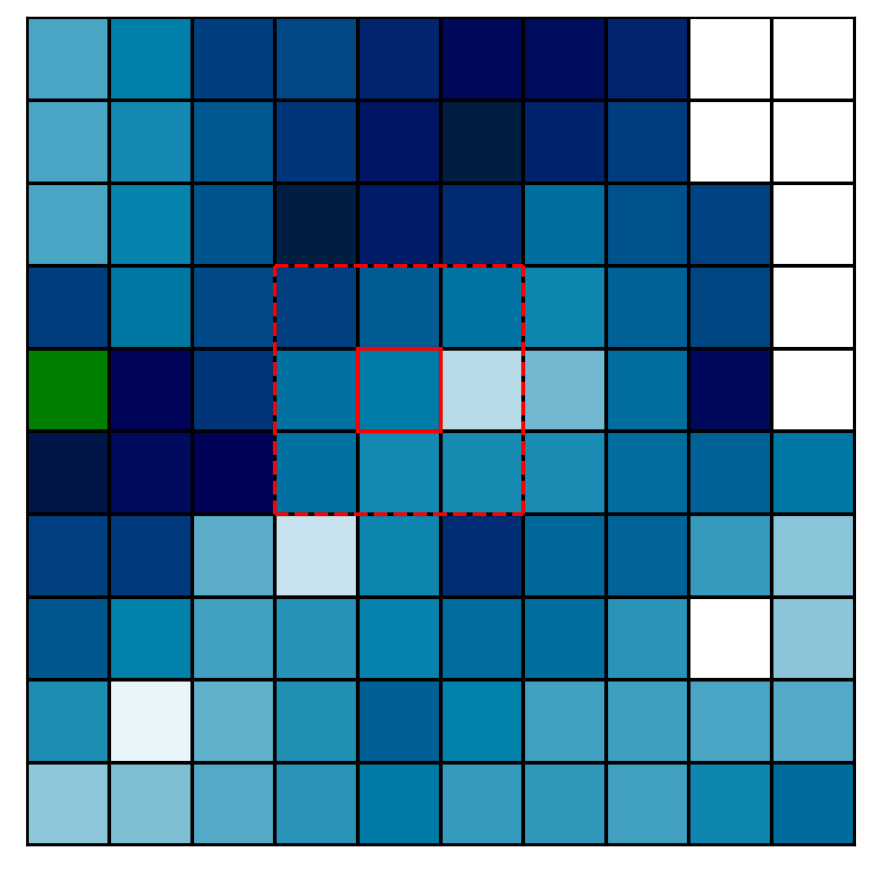
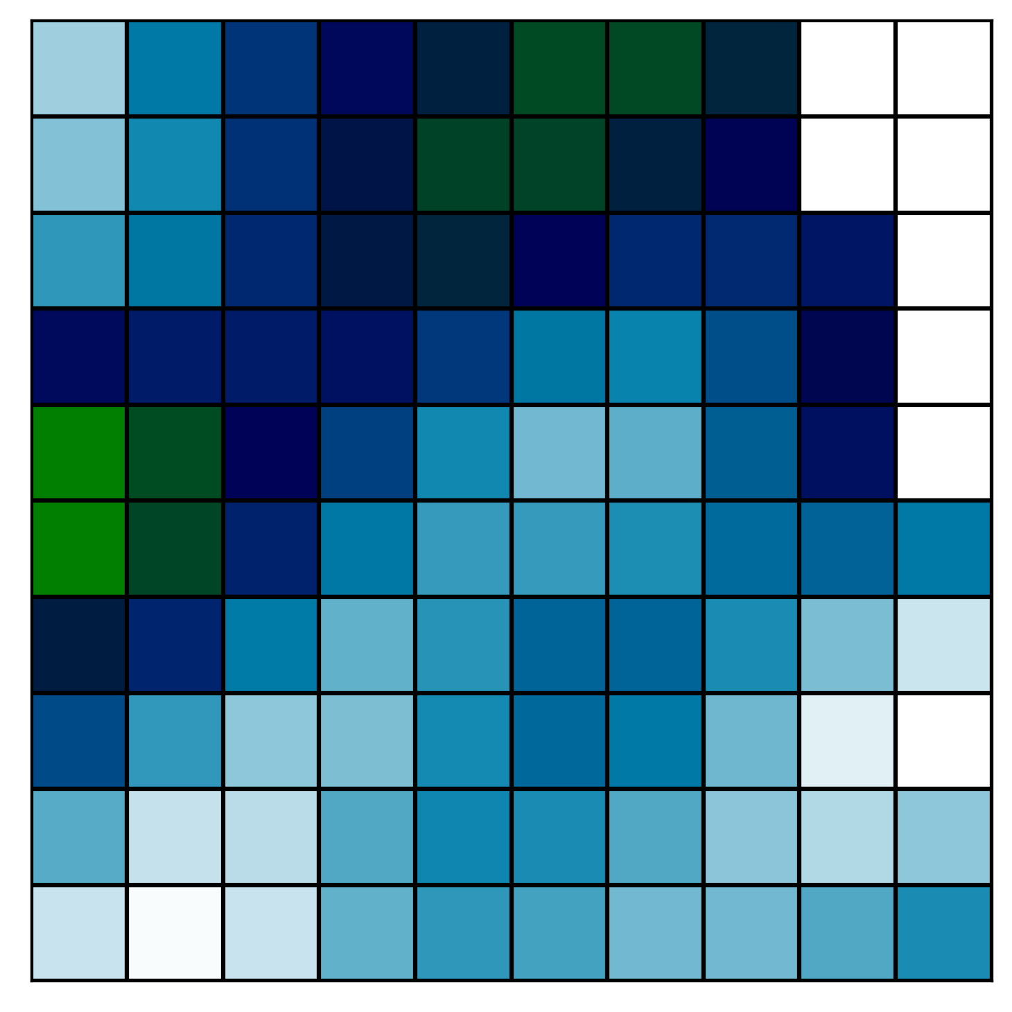
Gaussian Filtering
GitHub: https://github.com/jerryweihuajing/Post-Processing

Slide 25
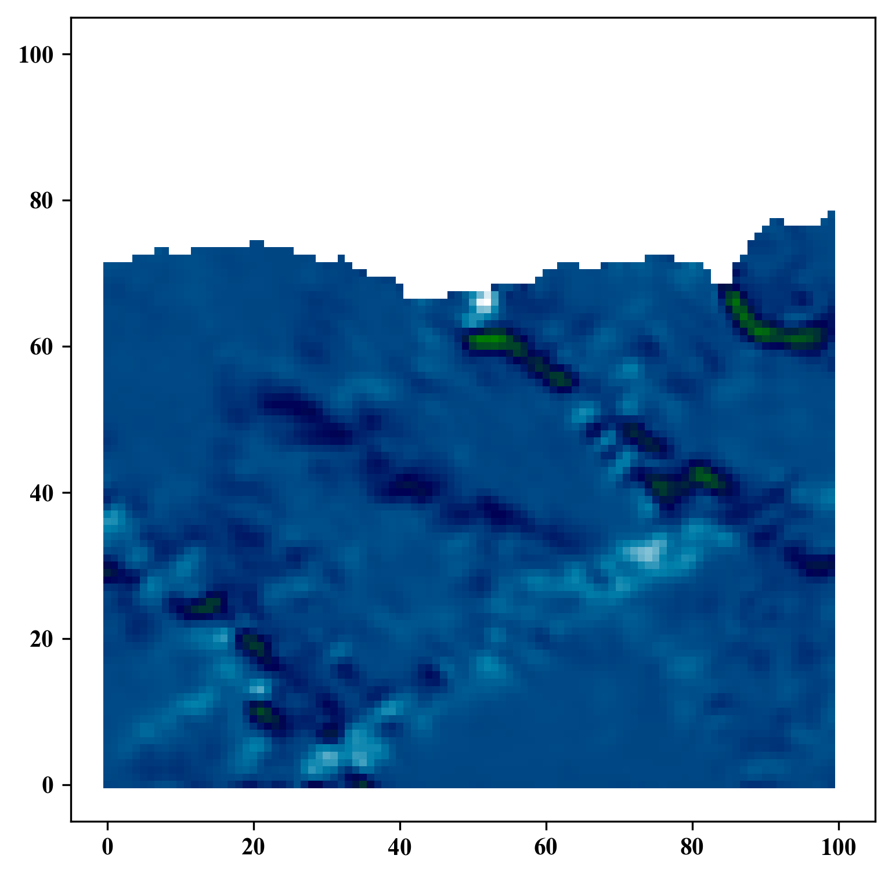
Gaussian Filtering
GitHub: https://github.com/jerryweihuajing/Post-Processing

Slide 26
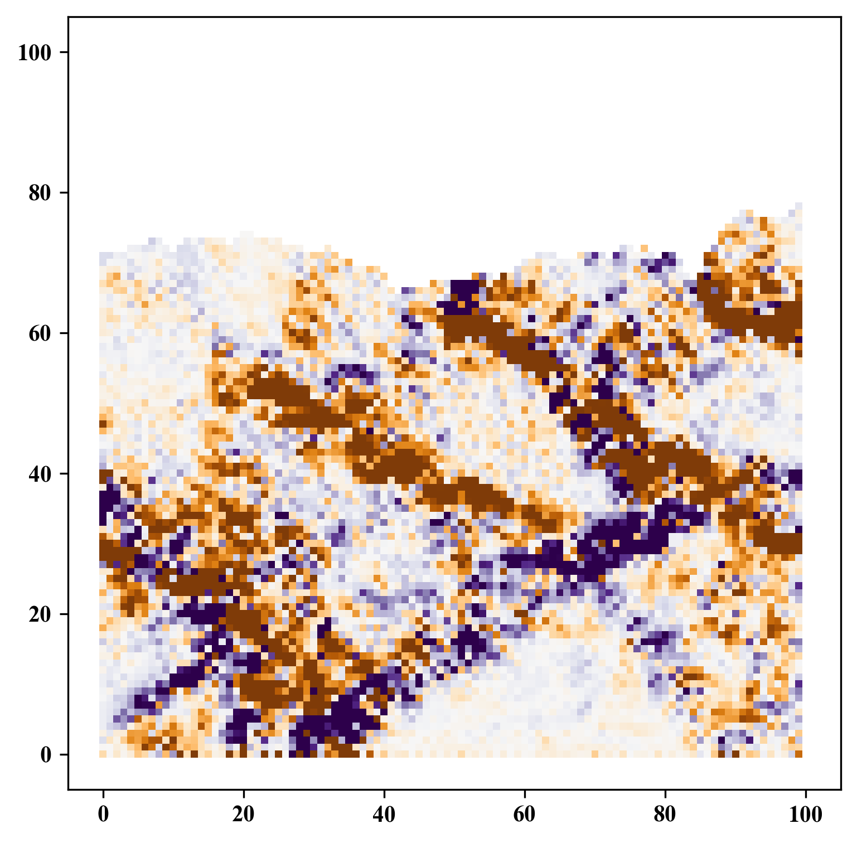
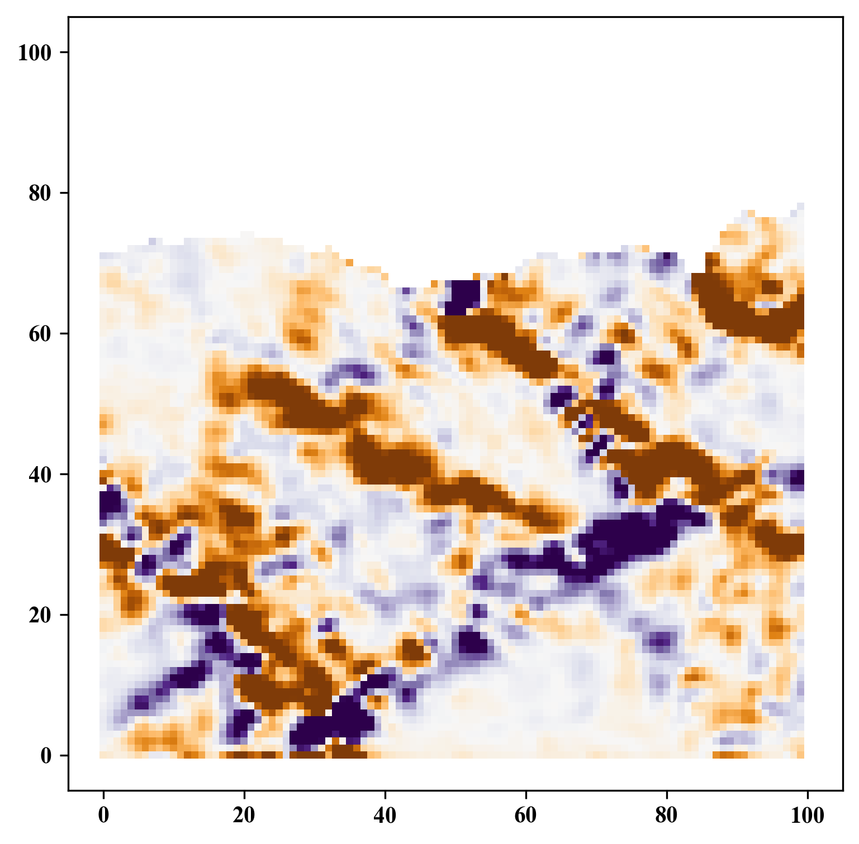
Gaussian Filtering
GitHub: https://github.com/jerryweihuajing/Post-Processing

Slide 27
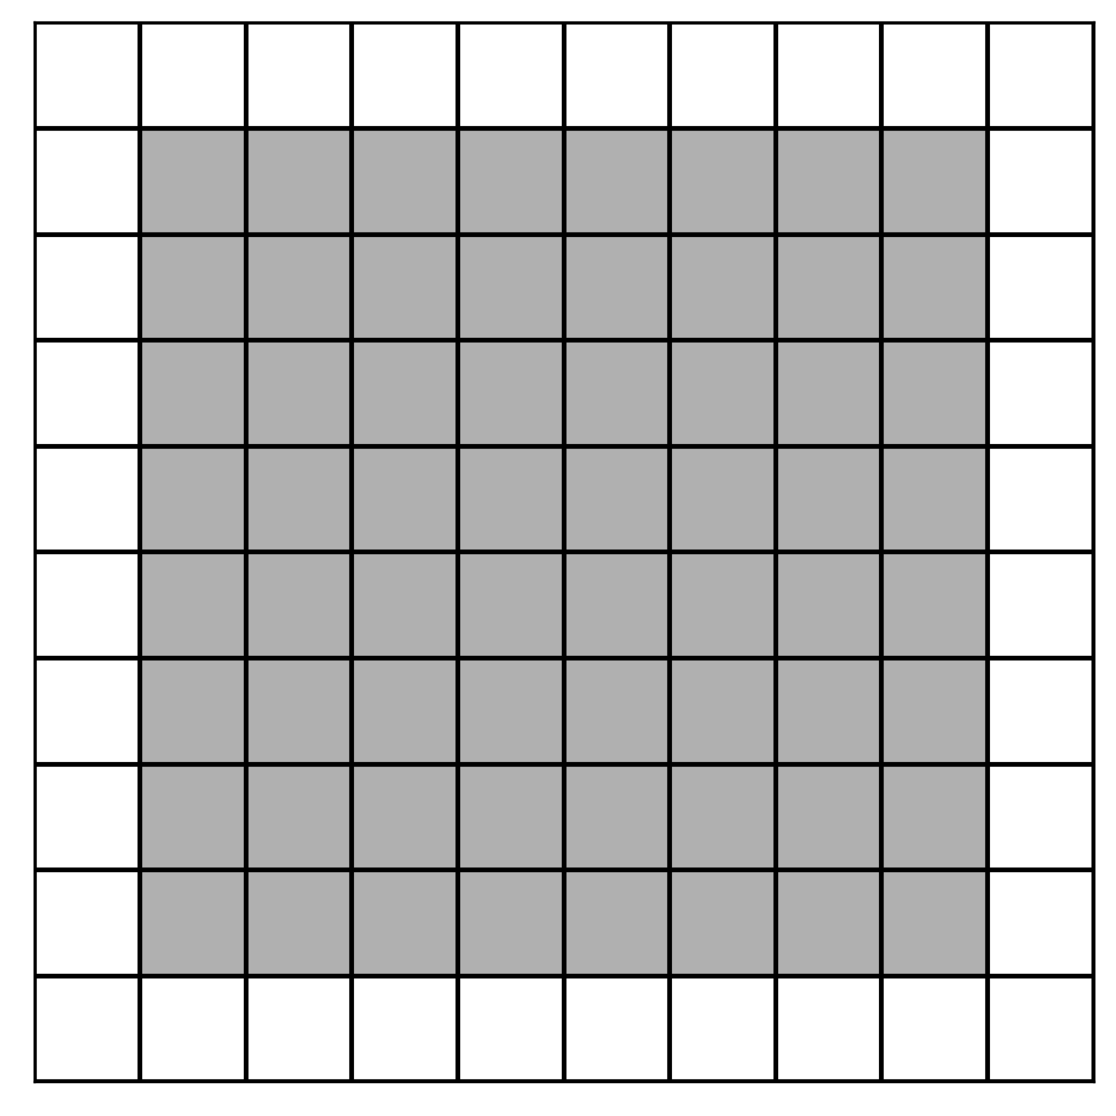
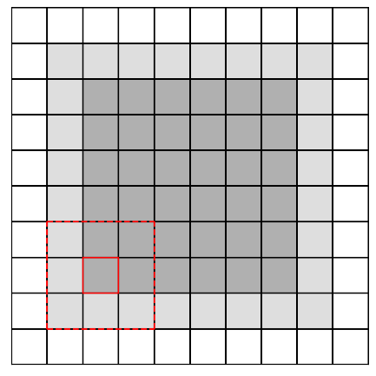
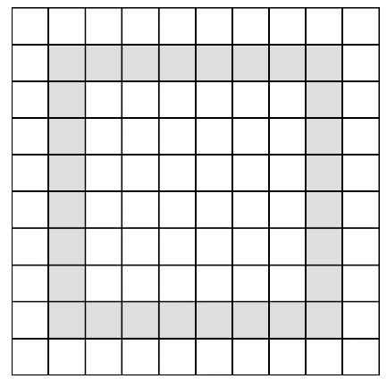
Boundary Extraction
GitHub: https://github.com/jerryweihuajing/Post-Processing

Slide 28
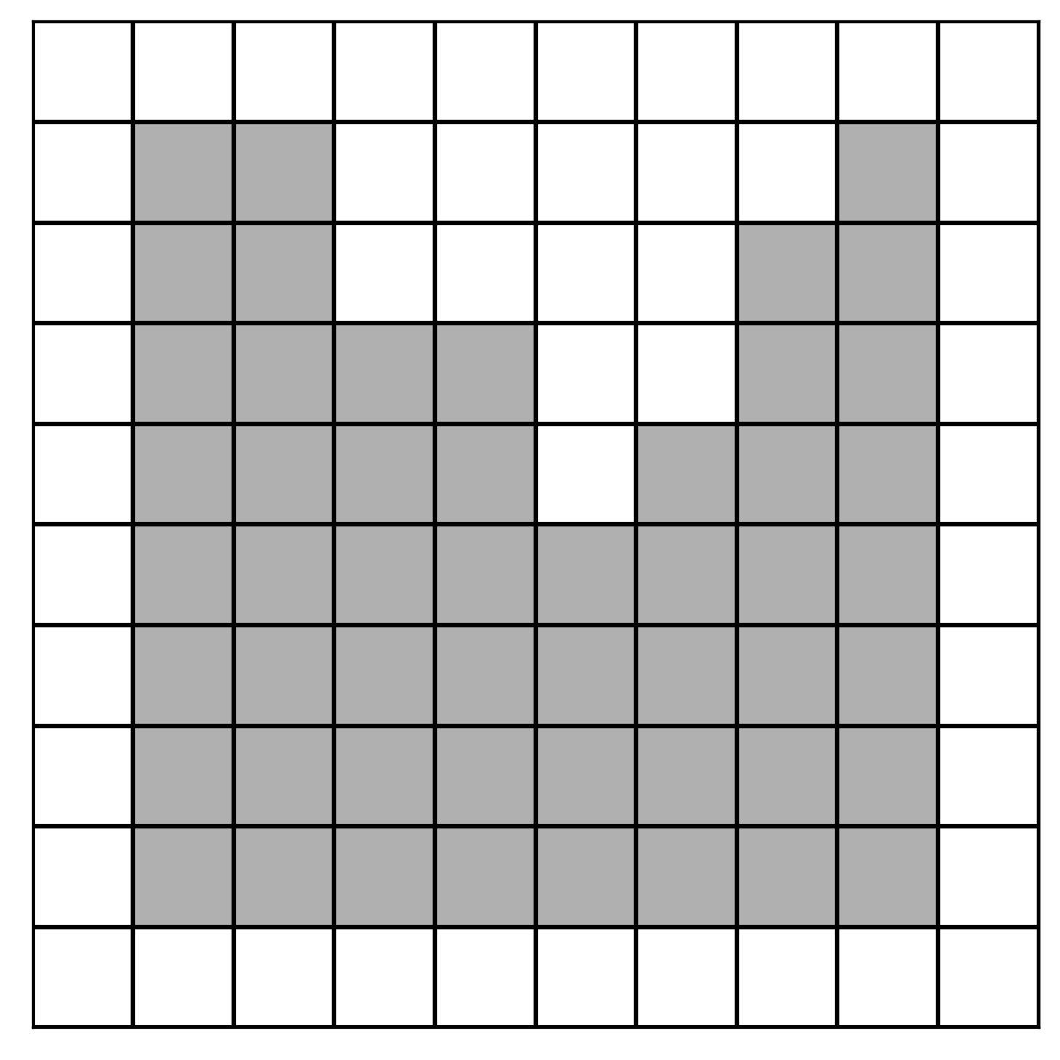


Boundary Extraction
GitHub: https://github.com/jerryweihuajing/Post-Processing

Slide 29

Boundary Extraction
GitHub: https://github.com/jerryweihuajing/Post-Processing

Slide 30

Boundary Extraction
GitHub: https://github.com/jerryweihuajing/Post-Processing

Slide 31

Outline Calculation
GitHub: https://github.com/jerryweihuajing/Post-Processing

Slide 32


Outline Calculation
GitHub: https://github.com/jerryweihuajing/Post-Processing

Slide 33



Outline Calculation
GitHub: https://github.com/jerryweihuajing/Post-Processing

Slide 34

Outline Calculation
GitHub: https://github.com/jerryweihuajing/Post-Processing

Slide 35
Outline
Introduction
Algorithm
Example
Experiment
Conclusion

Slide 36

Model

Slide 37

Structural Deformation

Slide 38


Mean Normal Stress & Maximal Shear Stress

Slide 39



Volumetric Strain

Slide 40



Distortional Strain

Slide 41



Velocity

Slide 42



X Displacement

Slide 43



Y Displacement

Slide 44



Velocity Gradient

Slide 45



X Displacement Gradient

Slide 46



X Displacement Gradient

Slide 47




Advantages of DEMpost

Slide 48





Advantages of DEMpost

Slide 49




Advantages of DEMpost

Slide 50
Outline
Introduction
Algorithm
Example
Experiment
Conclusion

Slide 51


Base

Slide 52


Salt Thickness

Slide 53


Salt Thickness

Slide 54




Salt Width

Slide 55




Salt(far away) Width

Slide 56




Salt Depth

Slide 57




Salt Offset

Slide 58




Fault Orientation

Slide 59




Fault Inclination(+)

Slide 60




Fault Inclination(-)

Slide 61




Fault Depth(+)

Slide 62




Fault Depth(-)

Slide 63


Fault Offset(+)

Slide 64


Fault Offset(+)

Slide 65


Fault Offset(-)

Slide 66


Fault Offset(-)

Slide 67




Fault Scale-from Bottom(+)

Slide 68




Fault Scale-from Bottom(-)

Slide 69




Fault Scale-from Surface(+)

Slide 70




Fault Scale-from Surface(-)

Slide 71
Conclusion

Slide 72
Acknowledgement
THANKS

